Slide 1
Topics
Version Control System
Git
Reference book: Pro Git Youtube: GitButler

Slide 2
What is a Version Control System
Version control (also known as revision control, source control, and source code management) is the
software engineering practice of recording changes to a file or set of files over time, so that you can recall
specific versions later.
A version control system is a software tool that automates version control.
open
Subversion
Git
Bazaar
CVS
Mercurial
centralized
distributed
IBM ClearCase
Perforce
proprietary

Slide 3
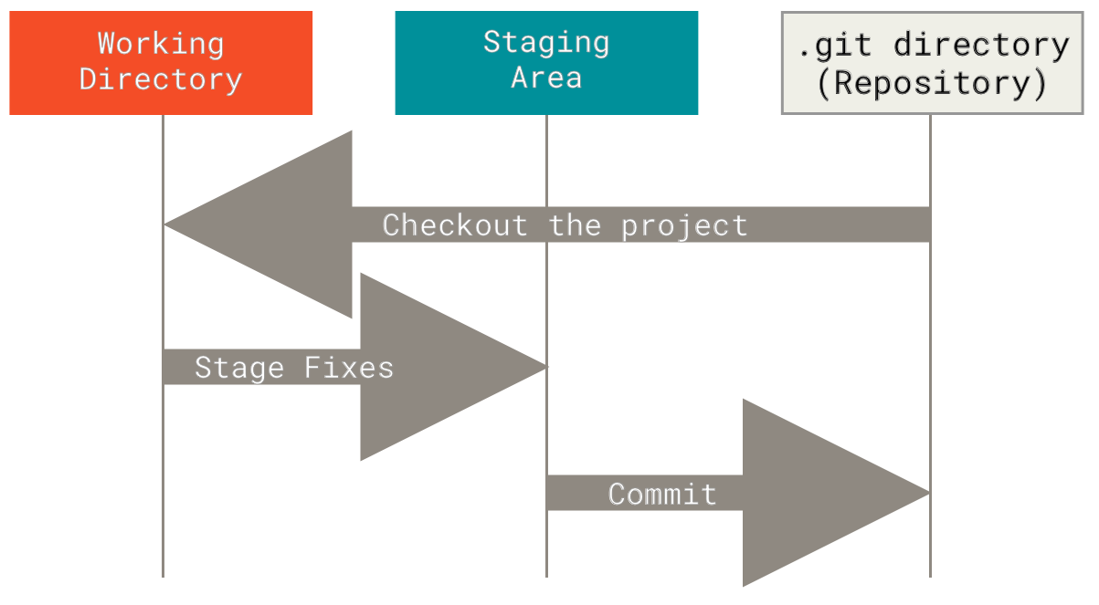
Why Git?
According to a SO survey, Git is used by more than 90% of developers, so it’s the de facto standard of VCS.
It’s a Distributed Version Control Systems => clients don’t just check out the latest snapshot of the files;
rather, they fully mirror the repository, including its full history => no dependency on any remote server.
The Three States:
Modified
means that you have changed the file but have not committed it to your database yet.
Staged
means that you have marked a
modified file in its current version to
go into your next commit snapshot.
Committed
means that the data is safely stored in your local database.

Slide 4
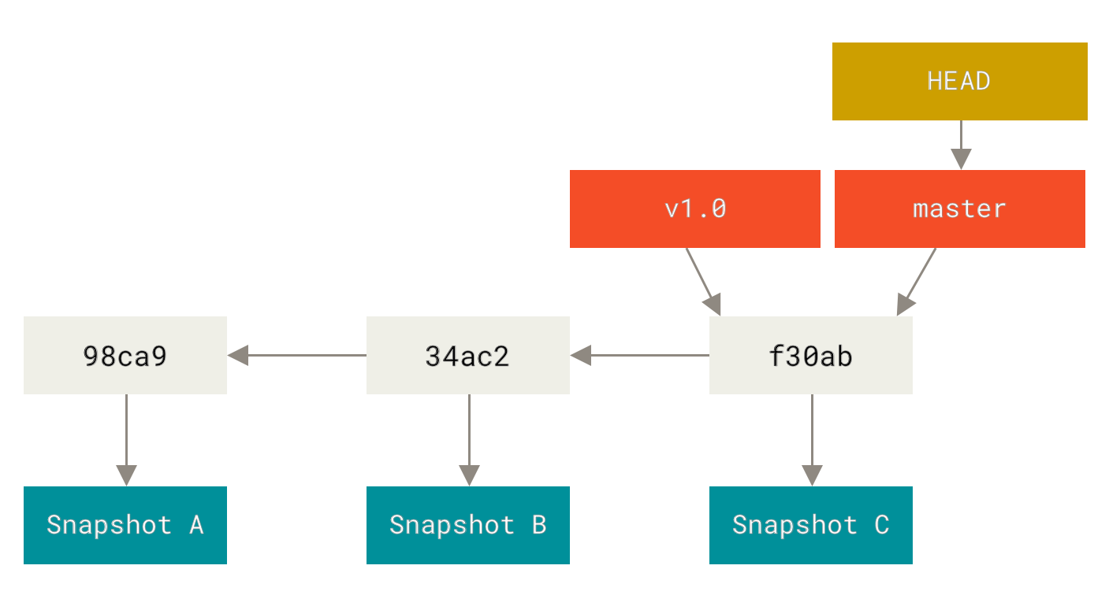
Basic workflow
time

Slide 5
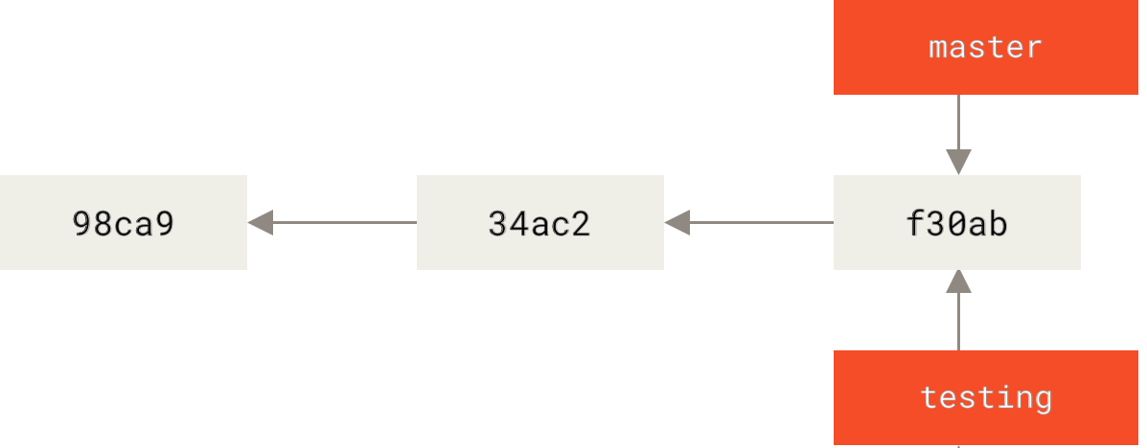
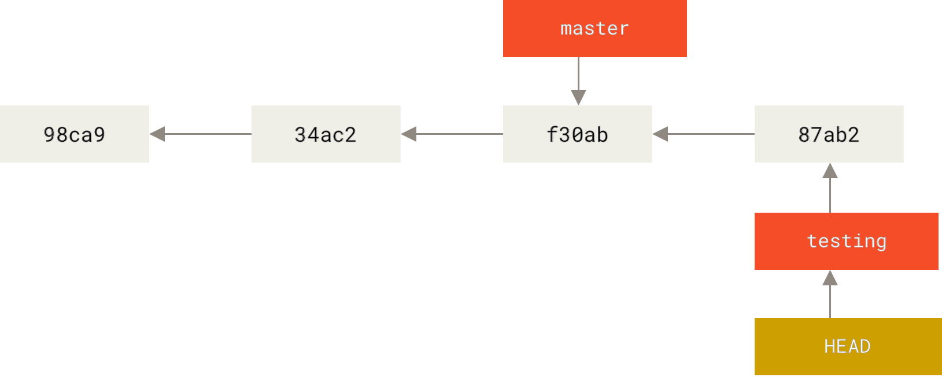
Branches
HEAD
git branch testing
git commit ...
git checkout testing
HEAD

Slide 6
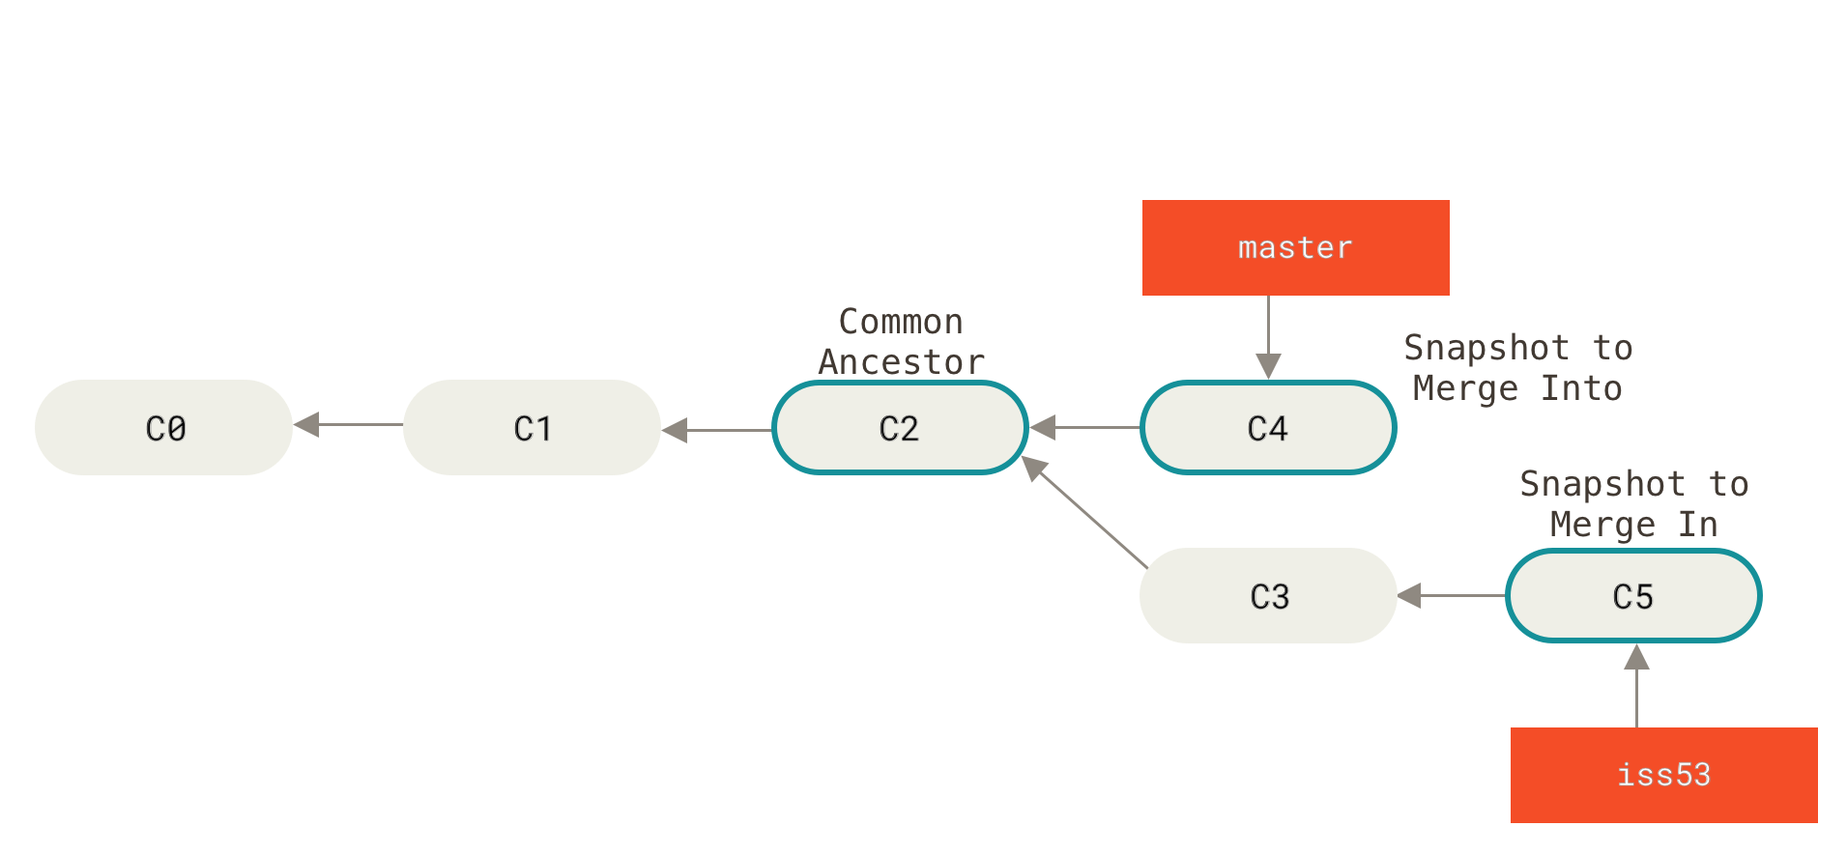
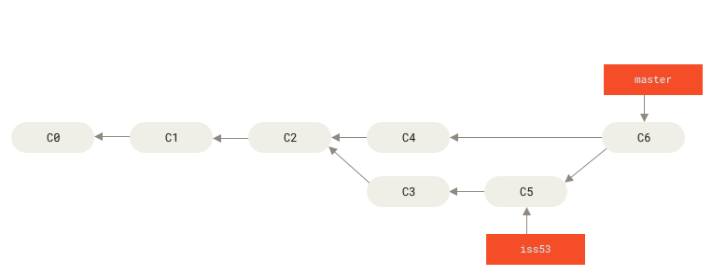
Merging (= creates a join point that preserves the complete history of how branches developed separately)
3-WAY MERGE!
(no-fast-forward)
--no-ff can force the no-fast-forward: => useful to keep track of the changes

Slide 7
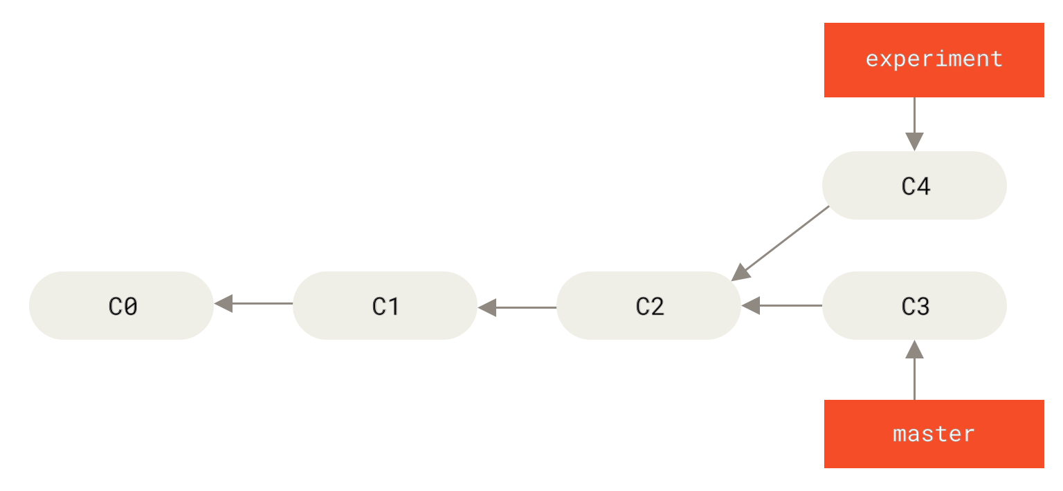
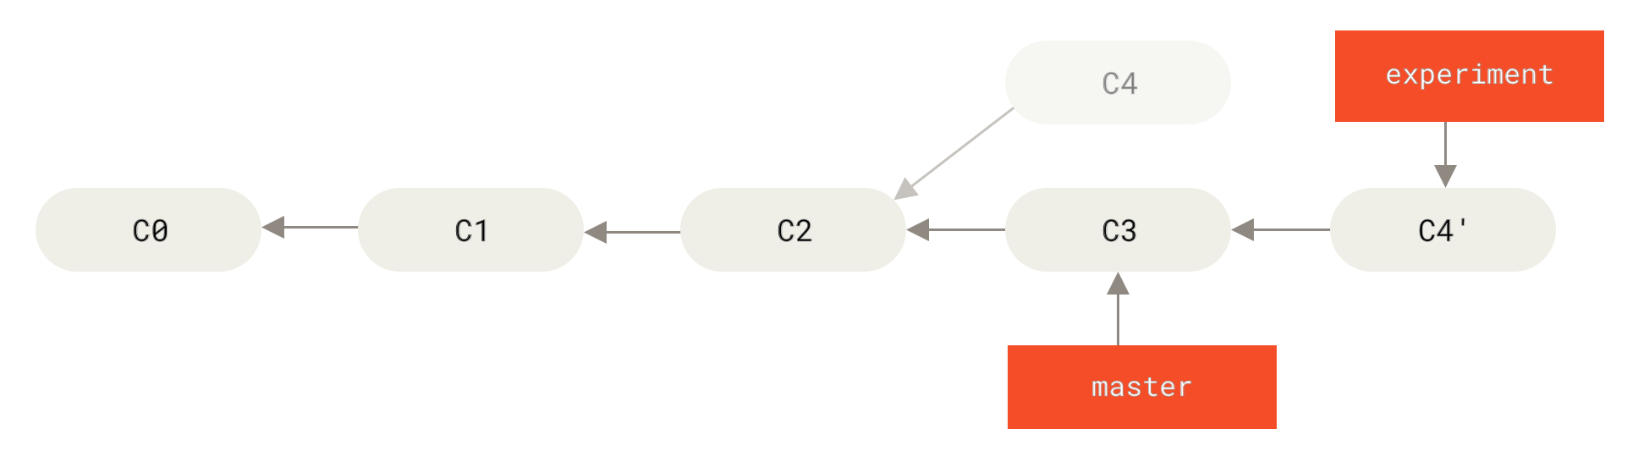
Rebasing (= rewrites history to create a linear progression as if development happened sequentially)
Swiss-army knife:
git rebase -i
Cherry-pick:
git cherry-pick <source>
git checkout experiment
git rebase master

Slide 8
Best practices
Atomic Commits Principle
Commit Messages
Don’t be short
Don’t be verbose
Add references (JIRA, Bugzilla, Sentry...)
Cherry-pick is not checkout!!!!
https://www.conventionalcommits.org

Slide 9
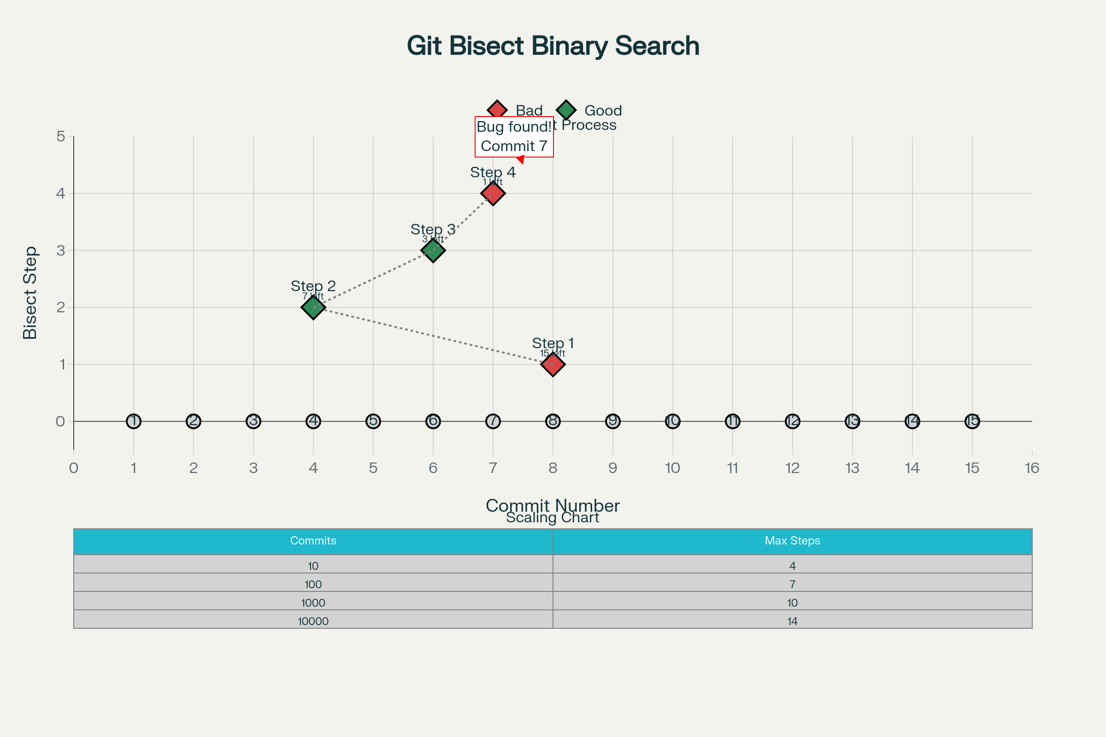
Bisecting
Git bisect uses binary search to efficiently find the exact commit that introduced a bug, dramatically reducing
the time needed to track down issues in large codebases.
git bisect start
git bisect bad // Mark HEAD as bad commit
git bisect good REF // Mark REF as good commit
...
test
git bisect bad (or good)
...
...
# commit def5678 is the first bad commit

Slide 10
Worktrees
Git worktrees allow you to have multiple working directories attached to the same repository. Perfect for working on multiple branches simultaneously without the need to stash or commit unfinished work.
# You're working on a feature
cd ~/projects/myapp
git checkout -b feature/user-dashboard
# ... working on feature, files are modified
# Urgent bug report comes in
# Instead of stashing/committing incomplete work:
git worktree add ../myapp-hotfix main
cd ../myapp-hotfix
git checkout -b hotfix/login-bug
# ... fix the bug
git add .
git commit -m "Fix login validation bug"
git push origin hotfix/login-bug
# Return to feature work
cd ~/projects/myapp
# Your work is still there, unchanged!

Slide 11
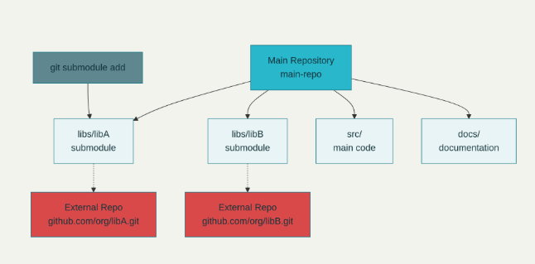
Submodules
Git submodules let a repository track specific commits from other repositories, providing a robust way to manage dependencies.
git submodule add https://github.com/org/libA.git libs/libA cd libs/libA
git checkout <commit-hash>
cd ../
git add libs/libA
git commit -m "Lock libA to specific commit"
A submodule is a snapshot reference to a specific commit of another repository, nested at a specified path in the main repository (the superproject).
Submodules are tracked in .gitmodules and represented by a special commit object in the main repository, not as regular files.
Each submodule has its own .git and history, which can be developed independently.

Slide 12
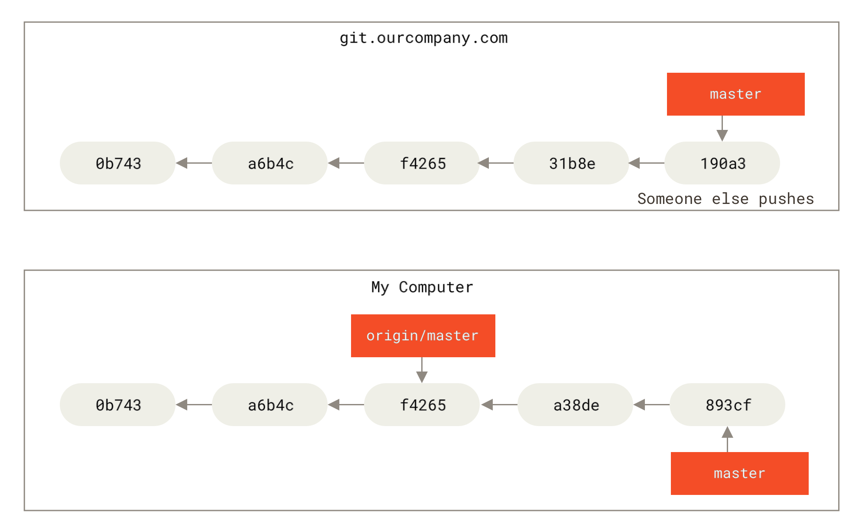
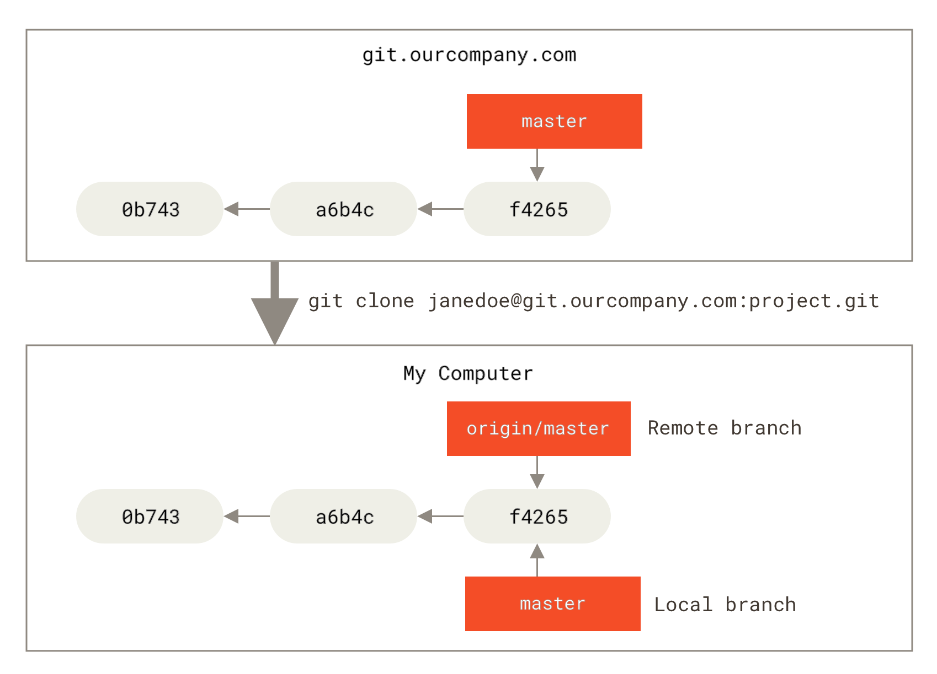
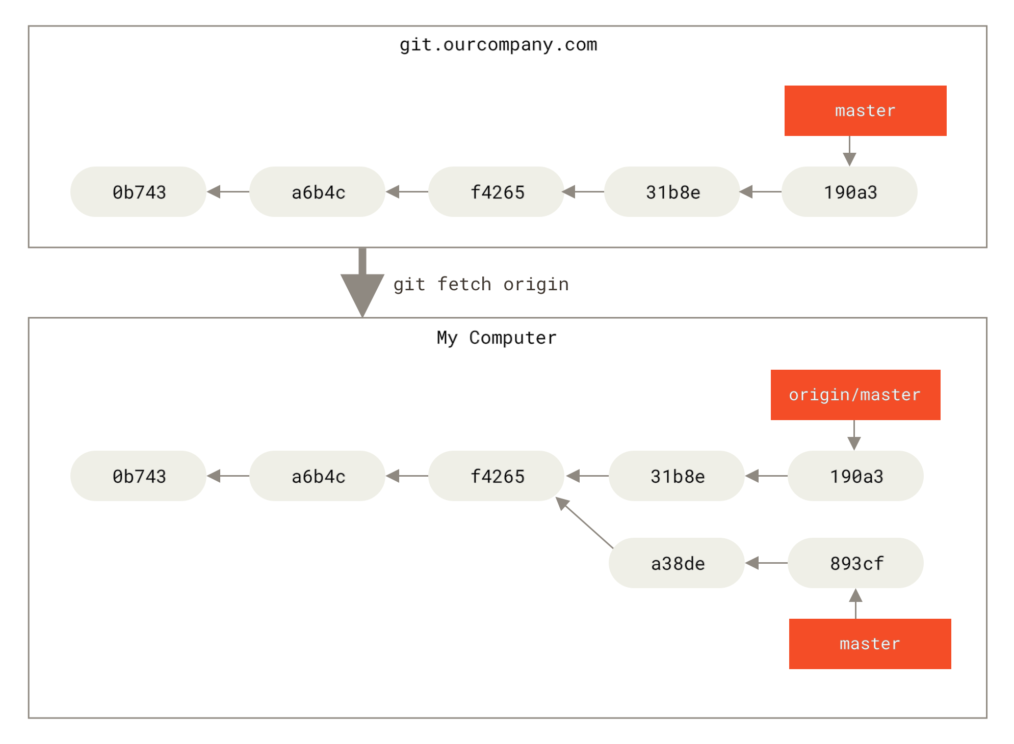
Remote branches
after some
remote work
fetch
Checking out a local branch from a remote-tracking branch automatically creates what is called a “tracking branch” (and the branch it tracks is called an “upstream branch”). Tracking branches are local branches that have a direct relationship to a remote branch. If you’re on a tracking branch and type git pull, Git automatically knows which server to fetch from and which branch to merge in.
fetch: just downloads data pull: fetch + merge

Slide 13
Github workflow
Easier to resync against the fork
Fork the repository
Create a specific branch for your task
Approved?
Push and create a PR to the source repository from your branch
Done
Review => Request a change
Do a change

